Slide 1
Predicting Rossmann Store Sales

Slide 2
Project Description
Our project aims at modeling the sales of these Rossmann stores and predicting their 6 weeks of sales to support the stores daily operation. The prediction would help the specific stores to schedule their staff more efficiently. I

Slide 3
Data Description
~1 million sales records
840,000 records of train dataset (open stores)
40,000 records of test dataset

Slide 4
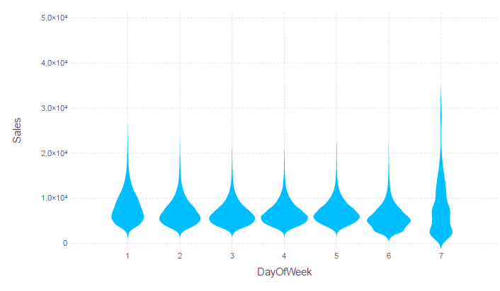
EDA
Figure 1. Sales distribution on different days of a week

Slide 5
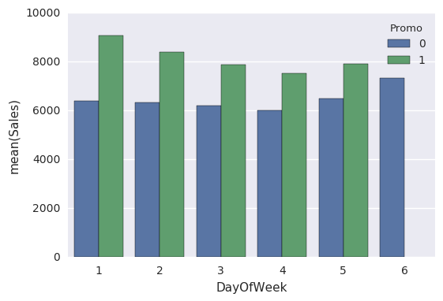
EDA
Figure 2. Mean sales of store No.1000 by DayofWeek, Promo

Slide 6
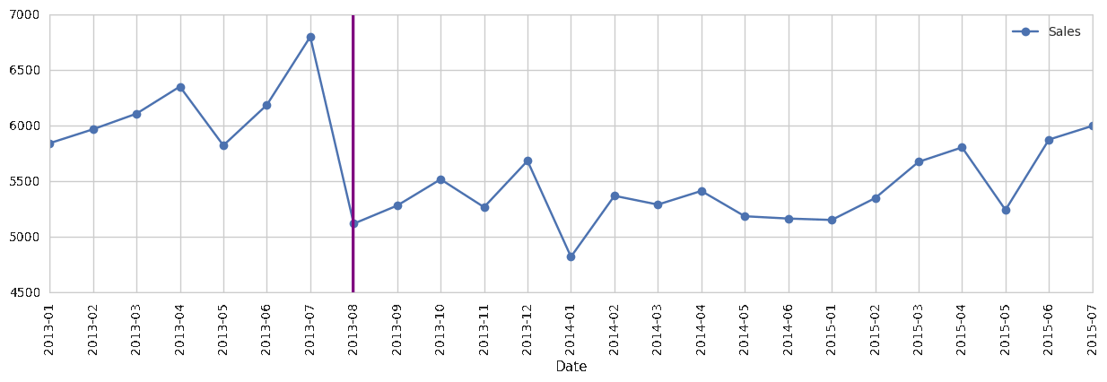
EDA
Figure 3. Sales trend of store No.191, competition since 2013.8

Slide 7
Feature Transformation
1. Categorical values:
DayOfWeek: isMon{0,1}, isTue{0,1}
StateHoliday: {a, b, c, d}
StoreType: {a, b, c, d}
2. CompetitionDistance, CompetitionSince
Stores w/ competitors
Stores w/o competitors yet (a very large distance)
3. Promo, PromoSince

Slide 8
Prediction
1. Model #1: Global model w/ basic features [DayOfWeek, SchoolHoliday, StateHoliday, Promo]
2. Model #2: Global model w/ additional features [Promo2, Assortment, StoreType, CompetitionDist]
Model | Train Error | Test Error
Linear Regression | 0.55255 | 0.45762
Huber Regression | 0.49168 | 0.39953
Model | Train Error | Test Error
Linear Regression | 0.55255 | 0.45762
Huber Regression | 0.49168 | 0.39953

Slide 9
Prediction
3. Model #3: Local model w/ basic features – each store one model
4. Model #4: Non-linear model – Random Forest
Model | Train Error | Test Error
Linear Regression | 0.05496 | 0. 15894
Huber Regression | 0.49168 | 0.39953
Model | Train Error | Test Error
Random Forest | 0.1362 | 0. 13845

